Slide 1
Emotion-Aware Customer Support Chatbot
DHIVYA R
MOHANAPRIYA R
ROSHINI S
RUSHA R

Slide 2
Problem Statement
Existing chatbots lack emotional intelligence, responding with generic answers.
Users often feel ignored or misunderstood, especially during complaints.
This leads to low satisfaction and poor user experience.
There is a need for a context-aware, empathetic chatbot that understands and responds based on user emotions.

Slide 3
Our Solution
Emotion Detection: Analyze customer input using a trained ML model to identify emotions based on tone, word choice, and sentiment.
Contextual Response Generation: Use Cohere to craft replies that align with the customer’s emotional state, ensuring relevance and empathy.
Instant, Personalized Support: Adapt responses in real time, improving customer satisfaction through emotionally intelligent interactions.

Slide 4
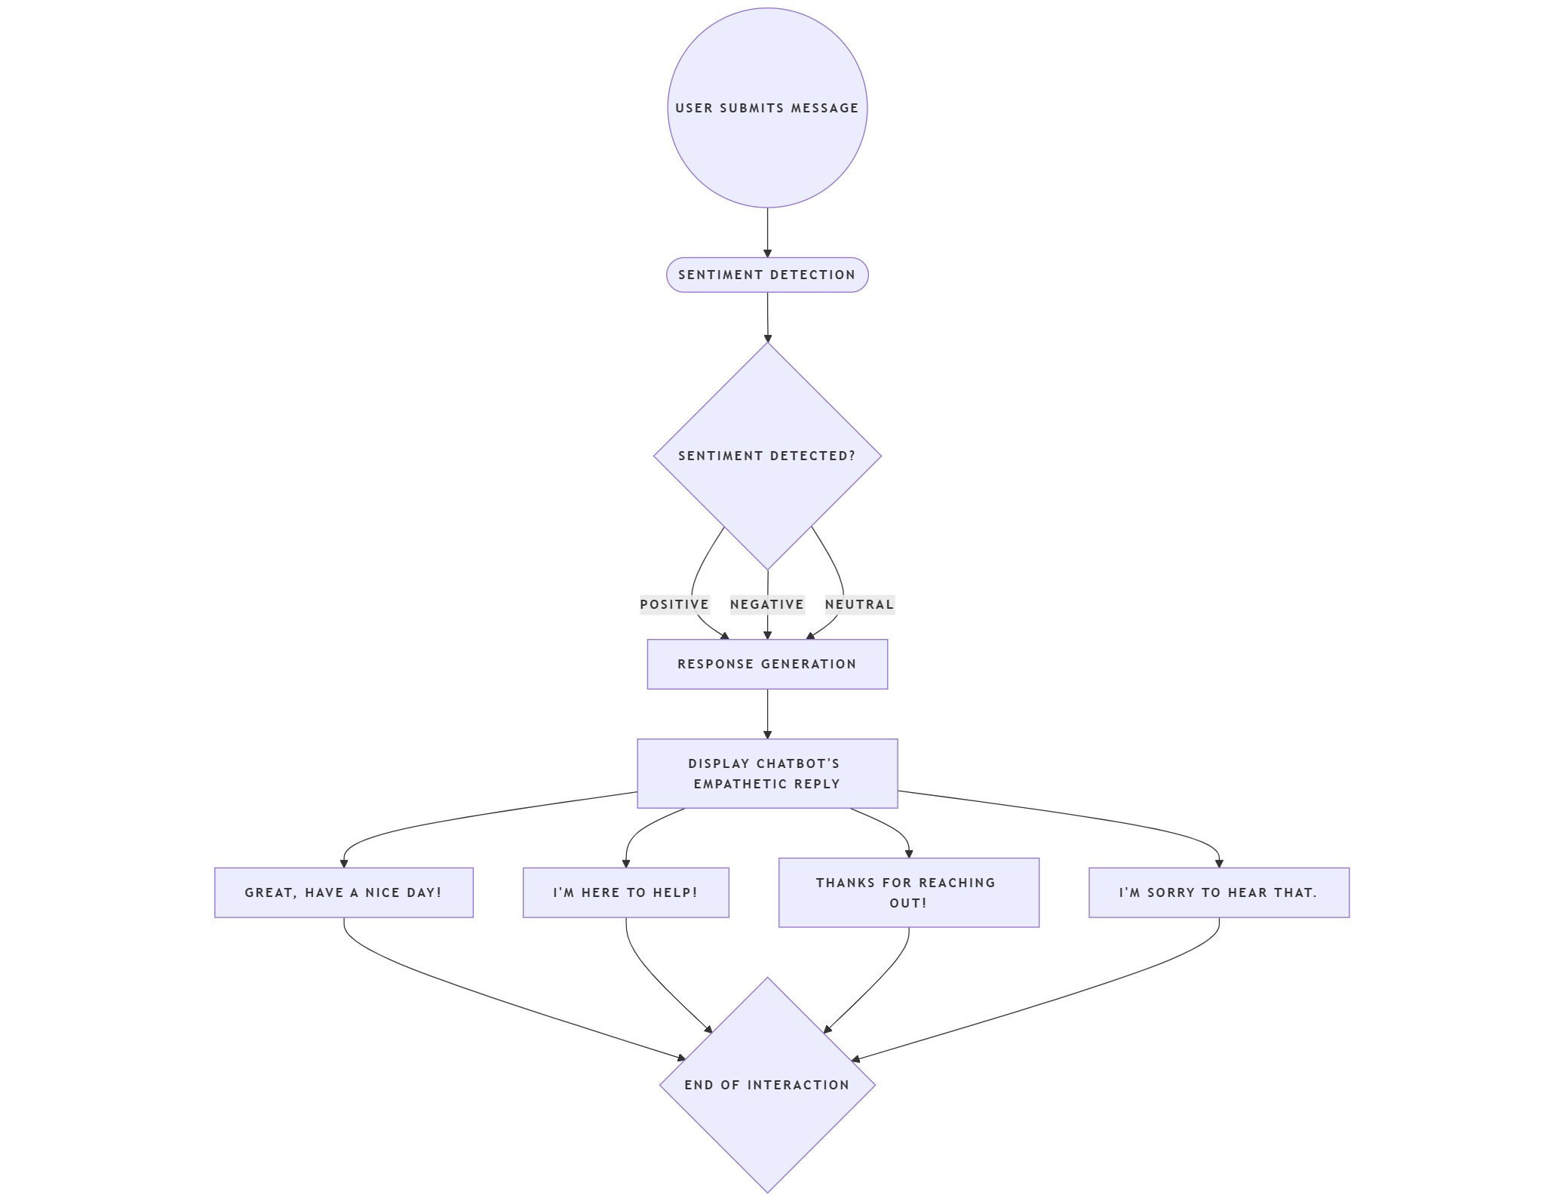
System Architecture

Slide 5
Technologies Used
Flask — Web Framework for building and deploying the chatbot
Cohere AI — Text Generation for creating context-aware, empathetic responses
Scikit-learn — Sentiment Analysis (Naive Bayes Classifier) for detecting emotions in user input
Joblib — Model Serialization for saving and loading the sentiment detection model
HTML/CSS — Frontend UI for creating a user-friendly interface

Slide 6
Machine Learning Model
Dataset: Tweet Emotions Dataset for training.
Preprocessing: Lowercasing and Punctuation Removal.
Feature Extraction: CountVectorizer to convert text to numerical format.
Algorithm: Multinomial Naive Bayes for sentiment analysis.
Pipeline: Combine CountVectorizer and Naive Bayes for sentiment detection.

Slide 7
Dynamic Response Generation
Sentiment-driven prompts:
Happy → Positive and cheerful response.
Sad → Sympathetic and supportive response.
Angry → Apologetic and solution-oriented response.
Neutral → Informative and helpful response.

Slide 8
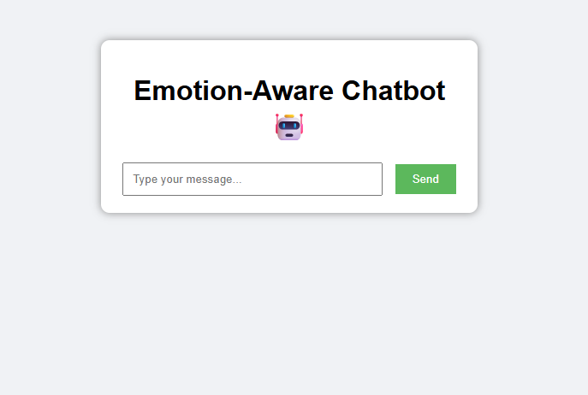
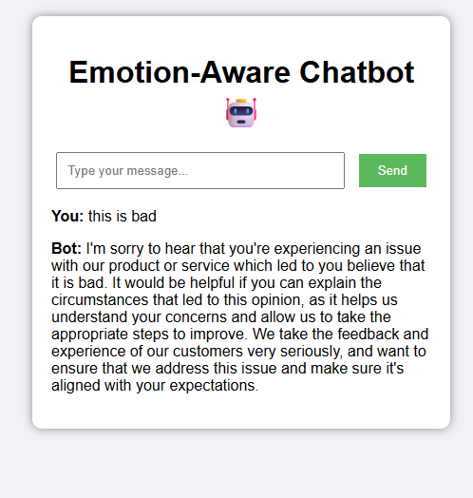
Demo Screenshots

Slide 9
Key Benefits
Improved Customer Satisfaction through timely and relevant interactions.
Real-time, personalized support tailored to individual needs.
Scalable solution to accommodate growing business demands.
Seamless integration with websites and mobile apps for easy access.

Slide 10
Future Enhancements
Multi-language Support for diverse customer needs.
Cohere model fine-tuning tailored to specific industries.
Continuous learning from customer interactions to improve responses.

Slide 11
Thank You!
Any Questions?

